Slide 1
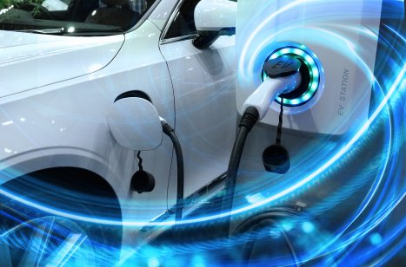
Electric vehicle analysis

Slide 2
Problem Statement:
Total Vehicles:
Understand the overall landscape of electric vehicles, encompassing both BEVs and PHEVs, to assess the market's size and growth.
2. Average Electric Range:
Determine the average electric range of the electric vehicles in the dataset to gauge the technological advancements and efficiency of the EVs.
3. Total BEV Vehicles and % of Total BEV Vehicles:
Identify and analyze the total number of Battery Electric Vehicles (BEVs) in the dataset.
Calculate the percentage of BEVs relative to the total number of electric vehicles, providing insights into the dominance of fully electric models.
4. Total PHEV Vehicles and % of Total PHEV Vehicles:
Identify and analyze the total number of Plug-in Hybrid Electric Vehicles (PHEVs) in the dataset.
Calculate the percentage of PHEVs relative to the total number of electric vehicles, offering insights into the market share of plug-in hybrid models.

Slide 3
Aim of the project:
The aim is to comprehensively understand the electric vehicle (EV) market landscape by determining the total number of EVs, assessing their average electric range, and analyzing the proportion of Battery Electric Vehicles (BEVs) and Plug-in Hybrid Electric Vehicles (PHEVs). This understanding will inform strategic decisions, product development initiatives, and market positioning strategies to capitalize on emerging trends and consumer preferences in the EV industry.

Slide 4

Project Scope
The project scope involves developing a robust Power BI project for in-depth analysis of electric vehicle (EV) data. This includes visualizing key metrics such as total EV count, electric range, and the distribution between Battery Electric Vehicles (BEVs) and Plug-in Hybrid Electric Vehicles (PHEVs). Through interactive dashboards and calculations, we aim to uncover insights into technological trends and market share dynamics.

Slide 5
Dataset Attributes
The dataset consists of the following columns:
VIN (1-10) , County , City , State, Postal Code , Model Year , Make, Model , Electric Vehicle Type, Clean Alternative Fuel Vehicle (CAFV) , Eligibility , Electric Range, Base MSRP , Legislative District ,DOL Vehicle ID, Vehicle Location ,Electric Utility, 2020 Census Tract 20 .

Slide 6

Total Electric Vehicles (since 2010)
DAX Formula:
Total Vehicles = DISTINCTCOUNT(Electric_Vehicle_Population_Data[DOL Vehicle ID])
Description:
This card displays the total count of electric vehicles since the year 2010.

Slide 7

Average Electric Range:
DAX Formula:
Avg Range = CONCATENATE(FORMAT(AVERAGE(Electric_Vehicle_Population_Data[Electric Range]),"0.00"),"km")
Description:
This card displays the average electric range of electric vehicles in kilometers. It calculates the average electric range based on the data provided since the year 2010, offering insights into the typical range of electric vehicles within the dataset.

Slide 8
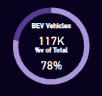
BEV Adoption Rate KPI
This doughnut chart represents the proportion of Battery Electric Vehicles (BEVs) out of the total electric vehicle population. The chart is composed of two segments:
BEV Vehicles Segment:
DAX Formula:
BEV Vehicles = CALCULATE([Total Vehicles],Electric_Vehicle_Population_Data[Electric Vehicle Type]="Battery Electric Vehicle (BEV)")
This segment represents the count of Battery Electric Vehicles (BEVs) in the dataset.
% of BEV Segment:
DAX Formula:
% of BEV = [BEV Vehicles]/[Total Vehicles]
This segment represents the percentage of BEVs out of the total electric vehicle population.

Slide 9
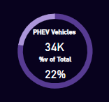
PHEV Adoption Rate KPI
The doughnut chart represents the proportion of Plug-in Hybrid Electric Vehicles (PHEVs) out of the total electric vehicle population. The chart is composed of two segments:
PHEV Vehicles Segment:
DAX Formula:
PHEV Vehicles = CALCULATE([Total Vehicles],Electric_Vehicle_Population_Data[Electric Vehicle Type]="Plug-in Hybrid Electric Vehicle (PHEV)")
This segment represents the count of Plug-in Hybrid Electric Vehicles (PHEVs) in the dataset.
% of PHEV Segment:
DAX Formula:
% of PHEV = [PHEV Vehicles]/[Total Vehicles]
This segment represents the percentage of PHEVs out of the total electric vehicle population.

Slide 10
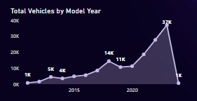
Total Vehicles by Model Year
The area chart visualizes the distribution of electric vehicles over the years, starting from 2010.
Each year is represented on the horizontal axis, while the total count of electric vehicles is displayed on the vertical axis.
The chart showcases the growth pattern and adoption trends of electric vehicles over time, providing insights into the evolution of the electric vehicle market.

Slide 11
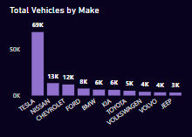
Total Vehicles by Make
The stacked column chart depicts the total count of electric vehicles by manufacturer or make.
Each column represents a manufacturer, with segments showing the distribution of vehicles across different makes.
It offers a quick visual comparison of market share among manufacturers, aiding in understanding the dominant players in the electric vehicle industry.

Slide 12
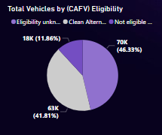
Total Vehicles by CAFV
The pie chart visualizes the distribution of electric vehicles based on their eligibility for Clean Alternative Fuel Vehicle (CAFV) incentives.
Each segment of the pie represents a category: vehicles eligible for CAFV incentives and vehicles not eligible for CAFV incentives.
The chart provides a clear comparison of the proportion of electric vehicles that qualify for these incentives versus those that do not.
This visualization aids in understanding the impact of incentives on electric vehicle adoption and highlights the potential drivers behind consumer choices.

Slide 13
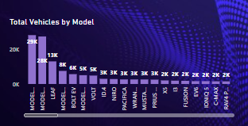
Total Vehicles by Model
It aggregates the count of vehicles for each model, enabling analysis of vehicle distribution across different models.
Each column on the chart represents a different model, and the segments within each column represent the distribution of vehicles .
This information can inform decision-making processes related to electric vehicle adoption, investment, and policy development.

Slide 14
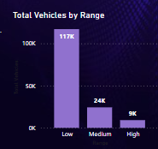
Total Vehicles by Range
The height of each column corresponds to the total number of vehicles for that particular range category.
DAX Formula:
Range =
SWITCH (
TRUE (),
Electric_Vehicle_Population_Data[Electric Range] <= 150, "Low",
Electric_Vehicle_Population_Data[Electric Range] <= 250, "Medium",
"High"
)
By analyzing this stacked column chart, stakeholders can gain insights into the distribution of vehicles across different electric range categories and understand how the vehicle models are distributed within each range category.

Slide 15
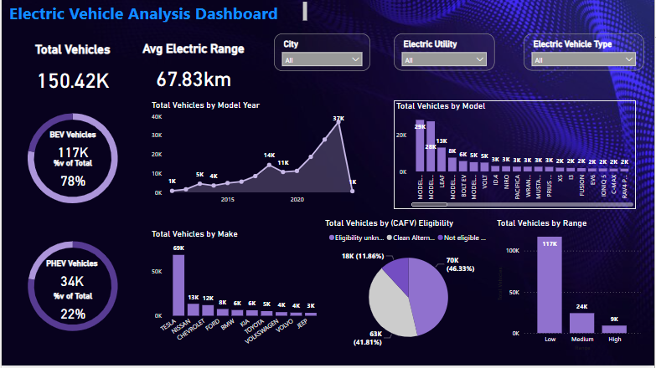

Slide 16
Key Insights from Visualizations:
The total count of electric vehicles since 2010 reaches 150.42k units.
The average electric range of electric vehicles is calculated to be approximately 67.83 kilometers.
The year 2023 stands out with the highest count of electric vehicles, reaching 37,079 units, indicating a significant surge in adoption and market penetration during that specific period.
Out of a total of 150k vehicles, 117k are Battery Electric Vehicles (BEV) and 34k are Plug-in Hybrid Electric Vehicles (PHEV) .
In the analysis of total vehicles by model, the Model Y stands out with the highest count of 28,502 vehicles.
Tesla emerges as a dominant player in the electric vehicle market, with a substantial count of 68,943 vehicles attributed to the brand.
With a count of 117k vehicles, the "Low" category stands out in the analysis of total vehicles by range.

Slide 17
Future Scope
The future scope of this project involves
forecasting market growth
evaluating brand performance
enhancing range technology, and
analyzing model preferences to drive strategic decision-making and market expansion in the electric vehicle industry.

Slide 18
Conclusion:
Overall, these insights emphasize the growing acceptance and adoption of EVs, driven by advancements in technology, supportive policies, and consumer preferences towards sustainable transportation options.
The growing momentum and diversity within the electric vehicle market, with Tesla leading the charge in innovation and market share.
Continued advancements in technology and infrastructure are likely to further accelerate the adoption of electric vehicles in the coming years.

